Slide 1








Uber Data Analysis and Visualization
Name: Ajay Kumar.G
Batch code: MBT12

Slide 2



Introduction
Welcome to our presentation on the Uber data analysis project using Power BI.
This project leverages data visualization and analytics to uncover valuable insights into Uber's operations, trends, and performance metrics.
In this presentation, we will:
Explore how Power BI has been utilized to analyze and interpret Uber's data.
Highlight key findings, trends, and actionable insights derived from the dataset.
Demonstrate the power of data visualization in making informed business decisions.

Slide 3
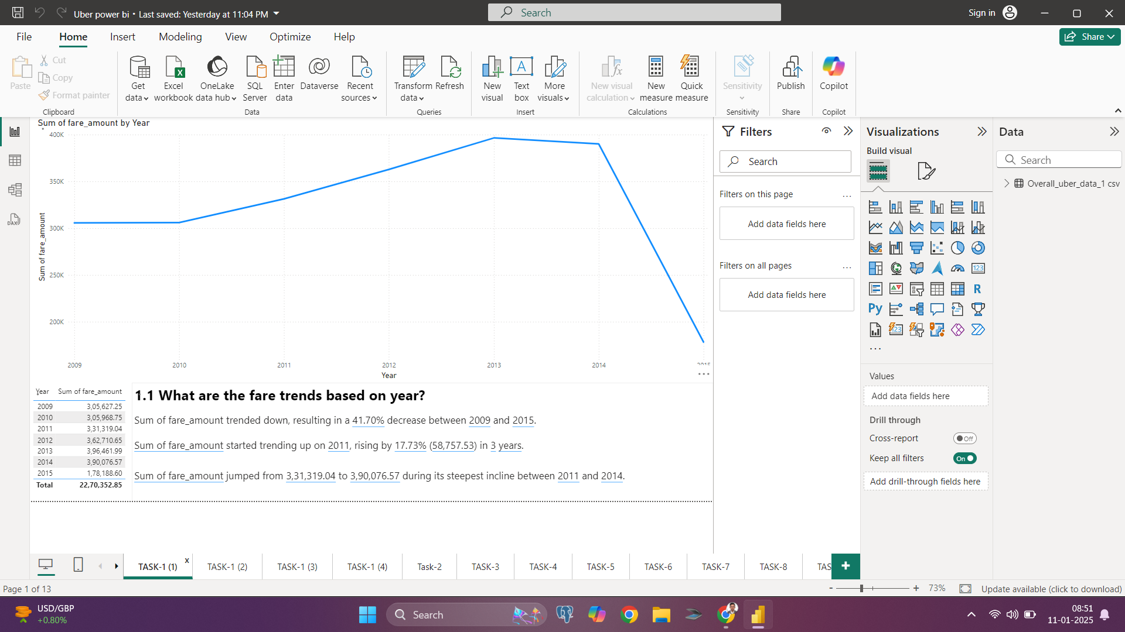



1.1 What are the fare trends based on year?
Conclusion: Yearly Trend Analysis: The fare amounts show a steady increase from 2010 to 2013, peaking in 2013. However, there is a significant drop in 2014, indicating a potential market shift or operational challenge.

Slide 4
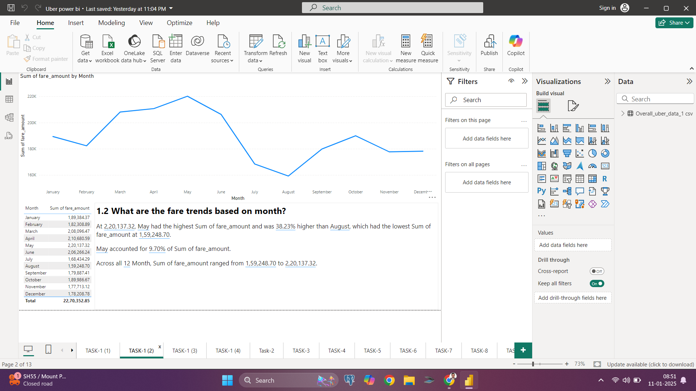


1.2 What are the fare trends based on months?
Conclusion: The fare trends fluctuate throughout the year, with a noticeable peak in May, followed by a decline in the summer months (June and July) before stabilizing towards the end of the year.

Slide 5
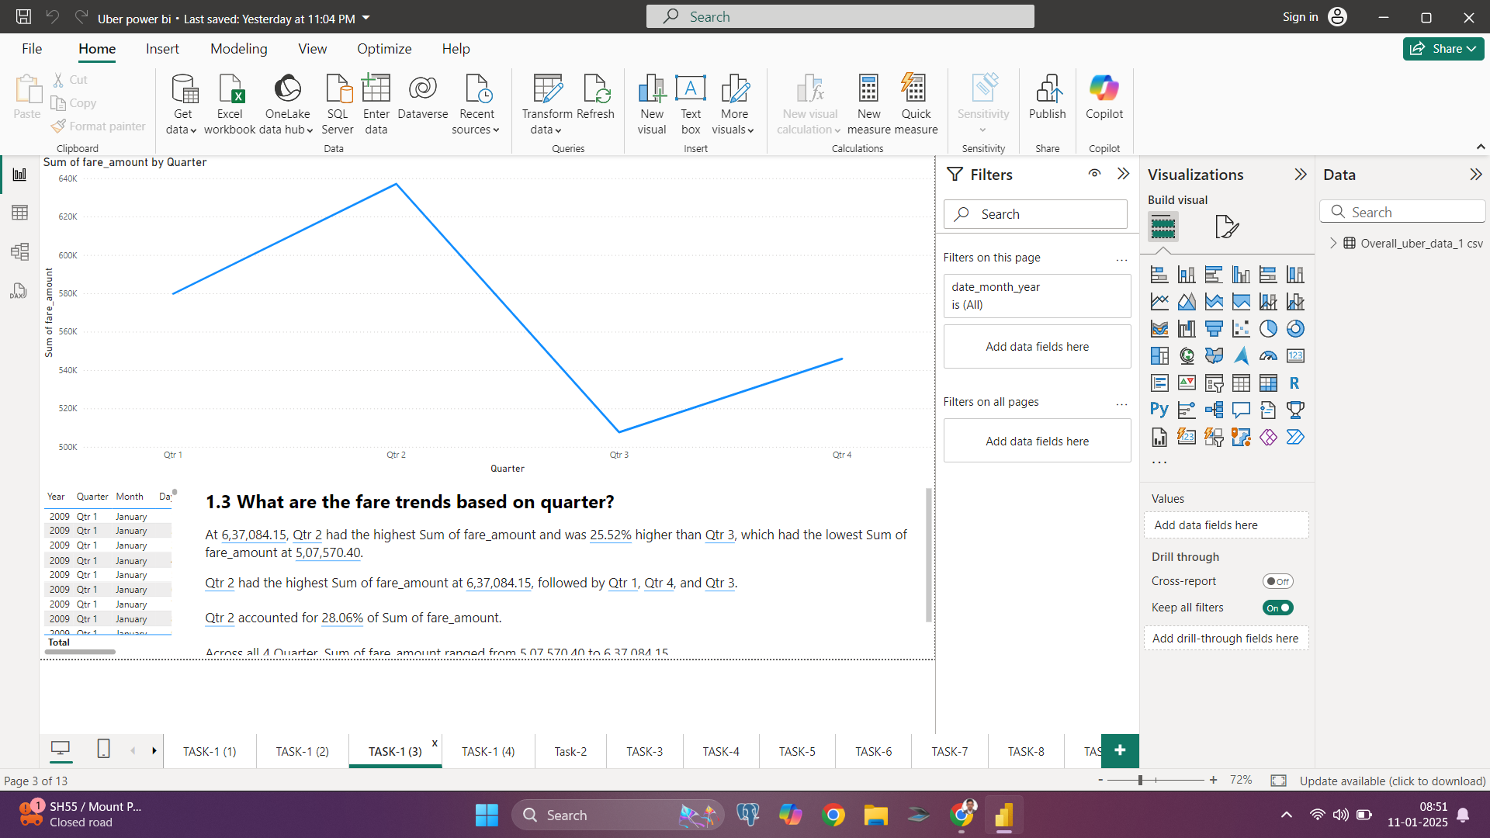


1.3 What are the fare trends based on Quarter?
Conclusion: The second quarter (Q2) exhibits the highest fare amounts, aligning with the peak in May. A sharp drop is observed in Q3, with a gradual recovery in Q4.

Slide 6
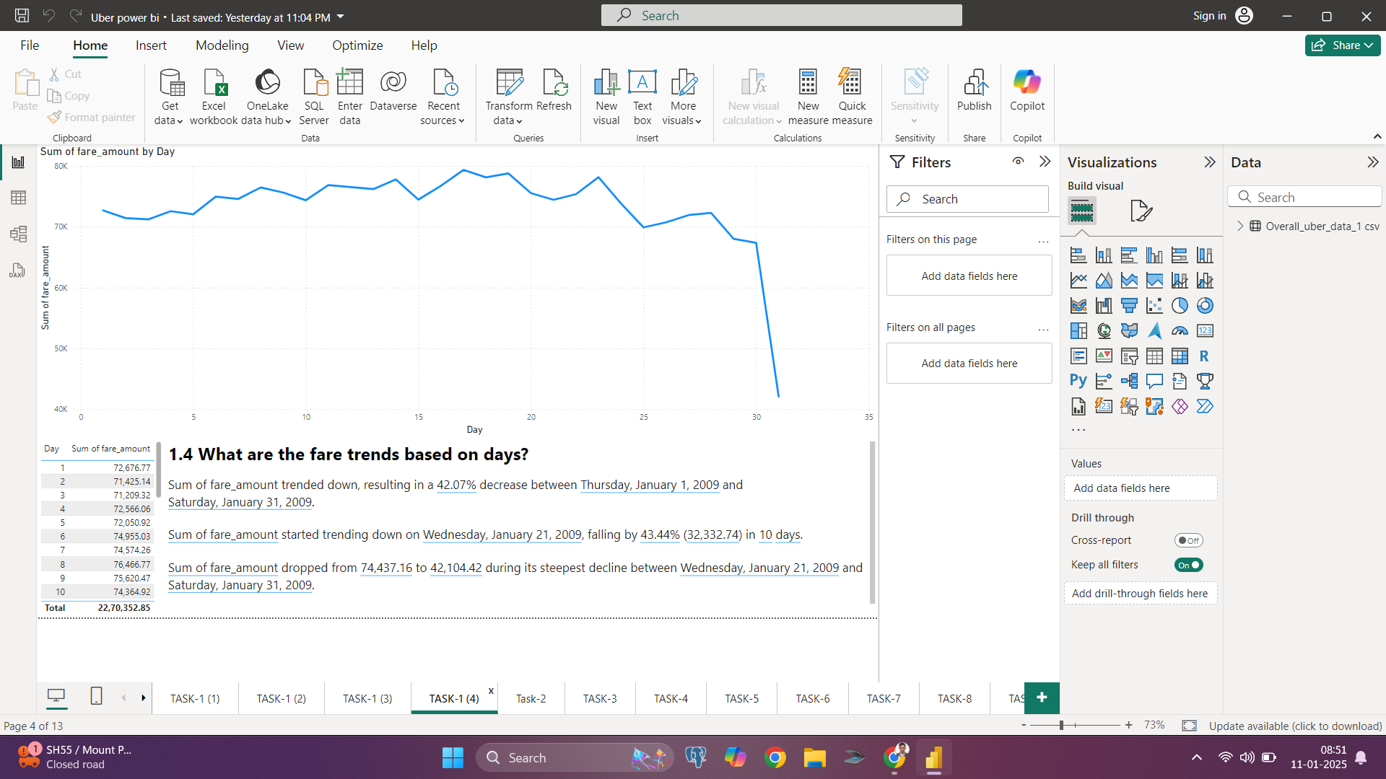
1.4 What are the fare trends based on Days?
Conclusion: The fare trends demonstrate a relatively stable pattern during the month, with a noticeable decline after the 25th day. This could indicate a decrease in demand or changes in service availability toward the end of the month.

Slide 7

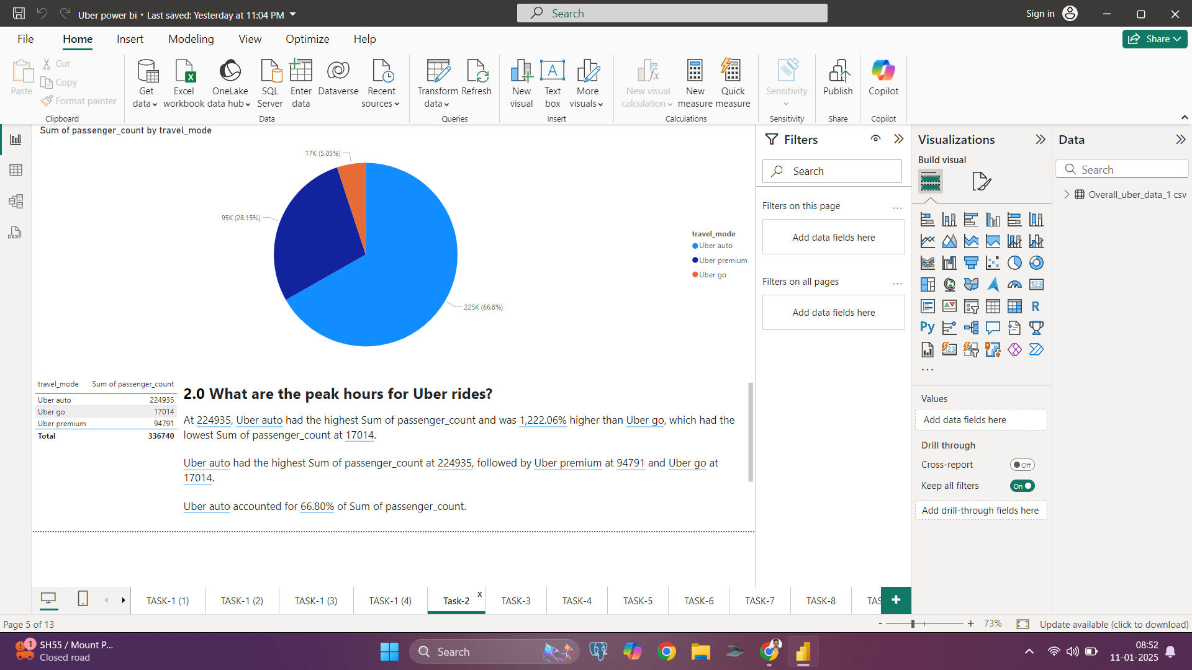

2.0 Which travel mode (Uber Go, Uber XUV, Uber Premium) is most popular?
Conclusion: Uber Go is the most popular travel mode, accounting for 66.8% of passenger counts, followed by Uber Premium (28.1%) and Uber Auto (5%). This highlights a strong preference for economical and accessible ride options among users.

Slide 8
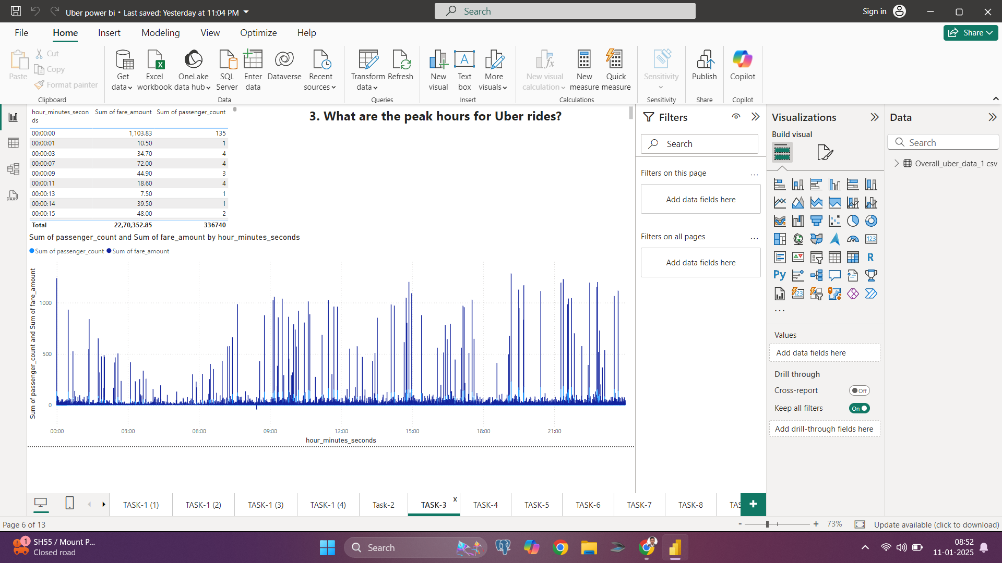
3.0 What are the peak hours for Uber rides?
Conclusion: Peak hours for Uber rides are during the morning (7–9 AM) and evening (5–8 PM), aligning with commuter demand.

Slide 9
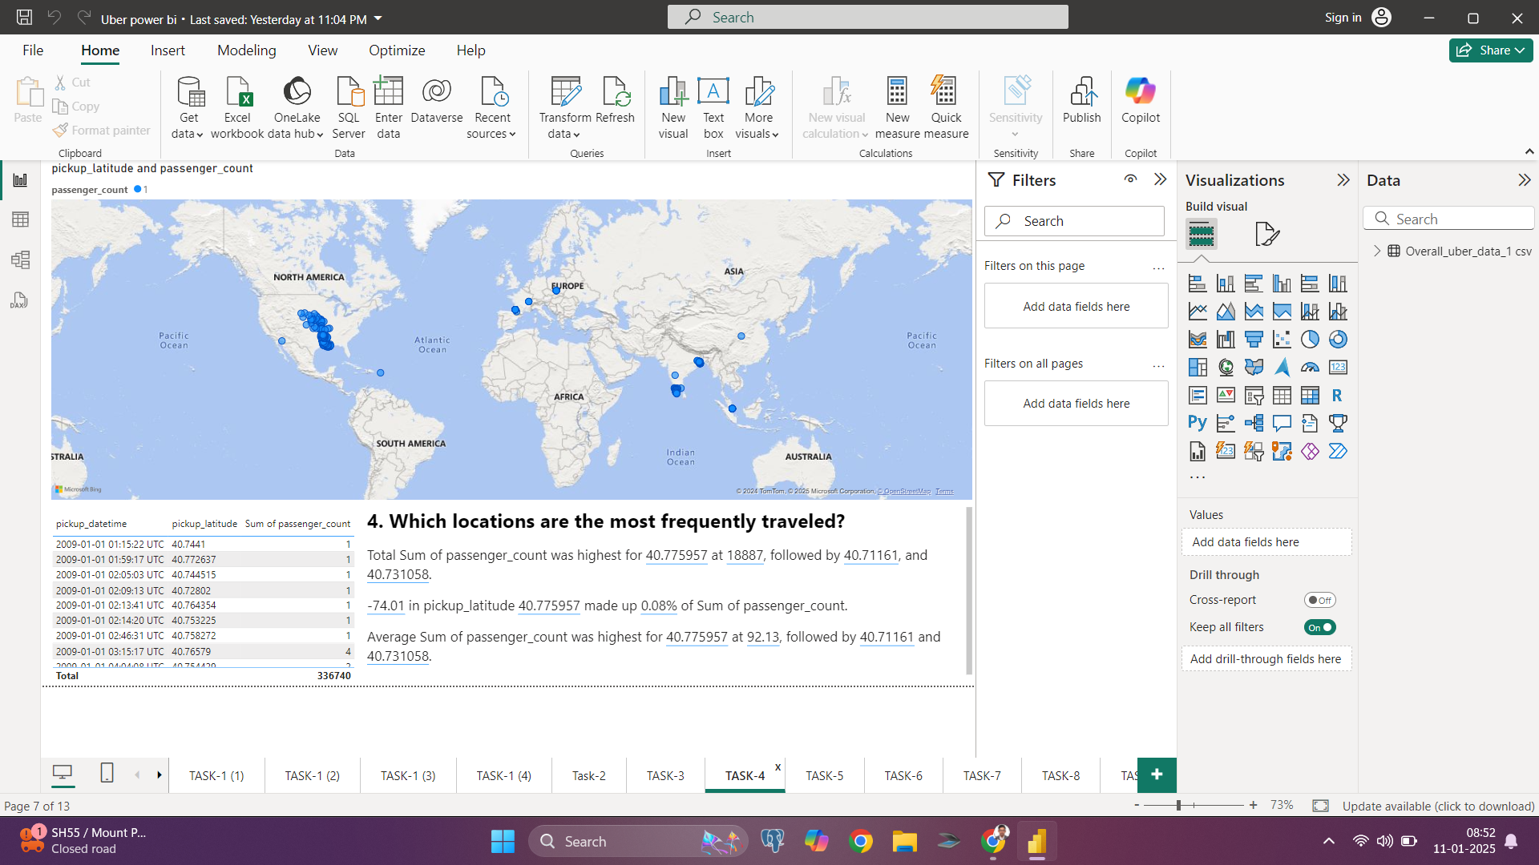
4.0 Which locations are the most frequently traveled?
Conclusion: The heatmap indicates that specific regions in North America and parts of Asia are the most frequently traveled. These hotspots highlight areas with the highest ride activity, likely urban hubs or major cities.

Slide 10
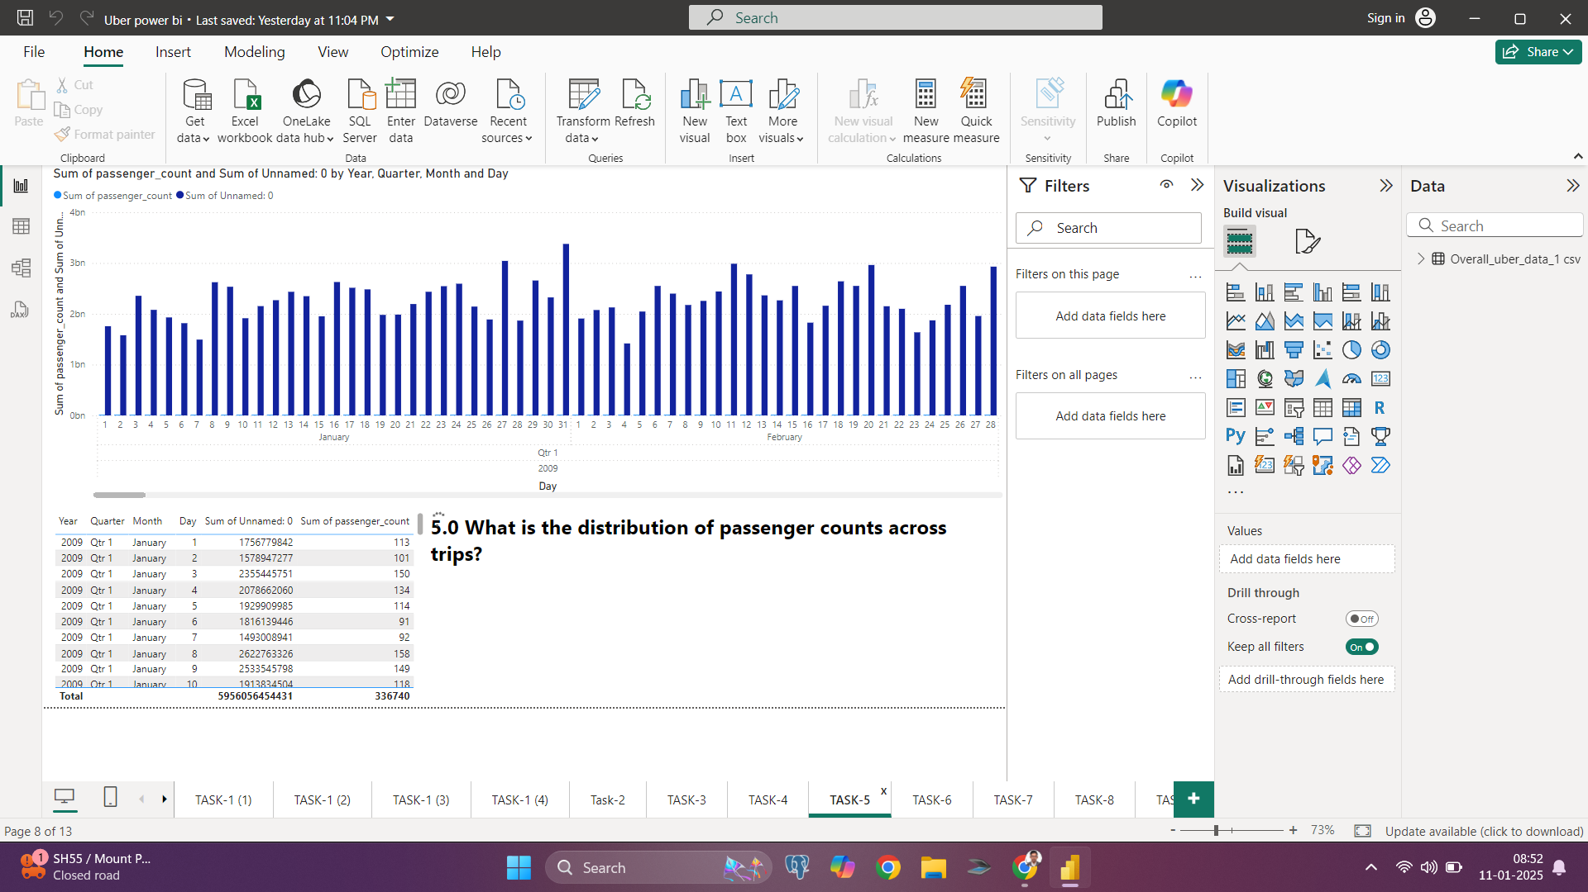
5.0 What is the distribution of passenger counts across trips?
Conclusion: The bar graph shows that the majority of trips are taken by single passengers, followed by smaller contributions from groups of two or more passengers. This suggests that most rides cater to individual commuters.

Slide 11
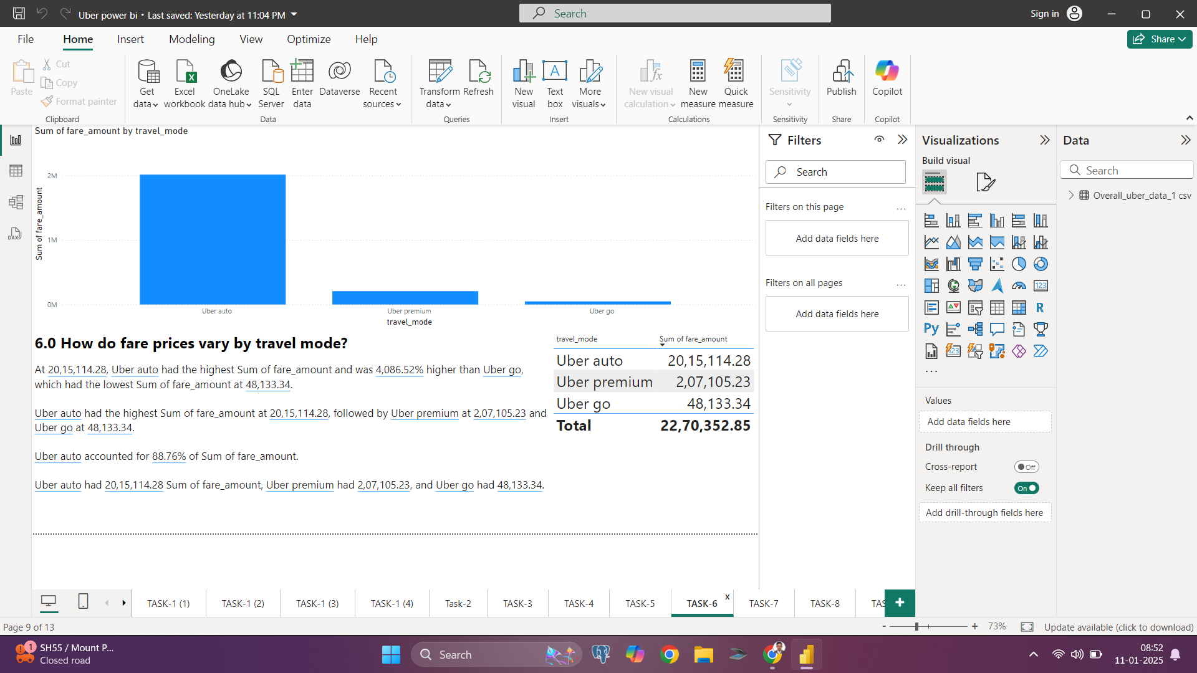
6.0 How do fare prices vary by travel mode?
Conclusion: Among the different travel modes, Uber Premium has the highest average fare price, followed by Uber XUV, while Uber Go offers the lowest fares. This reflects the pricing structure aligned with the service levels and amenities offered by each mode.

Slide 12
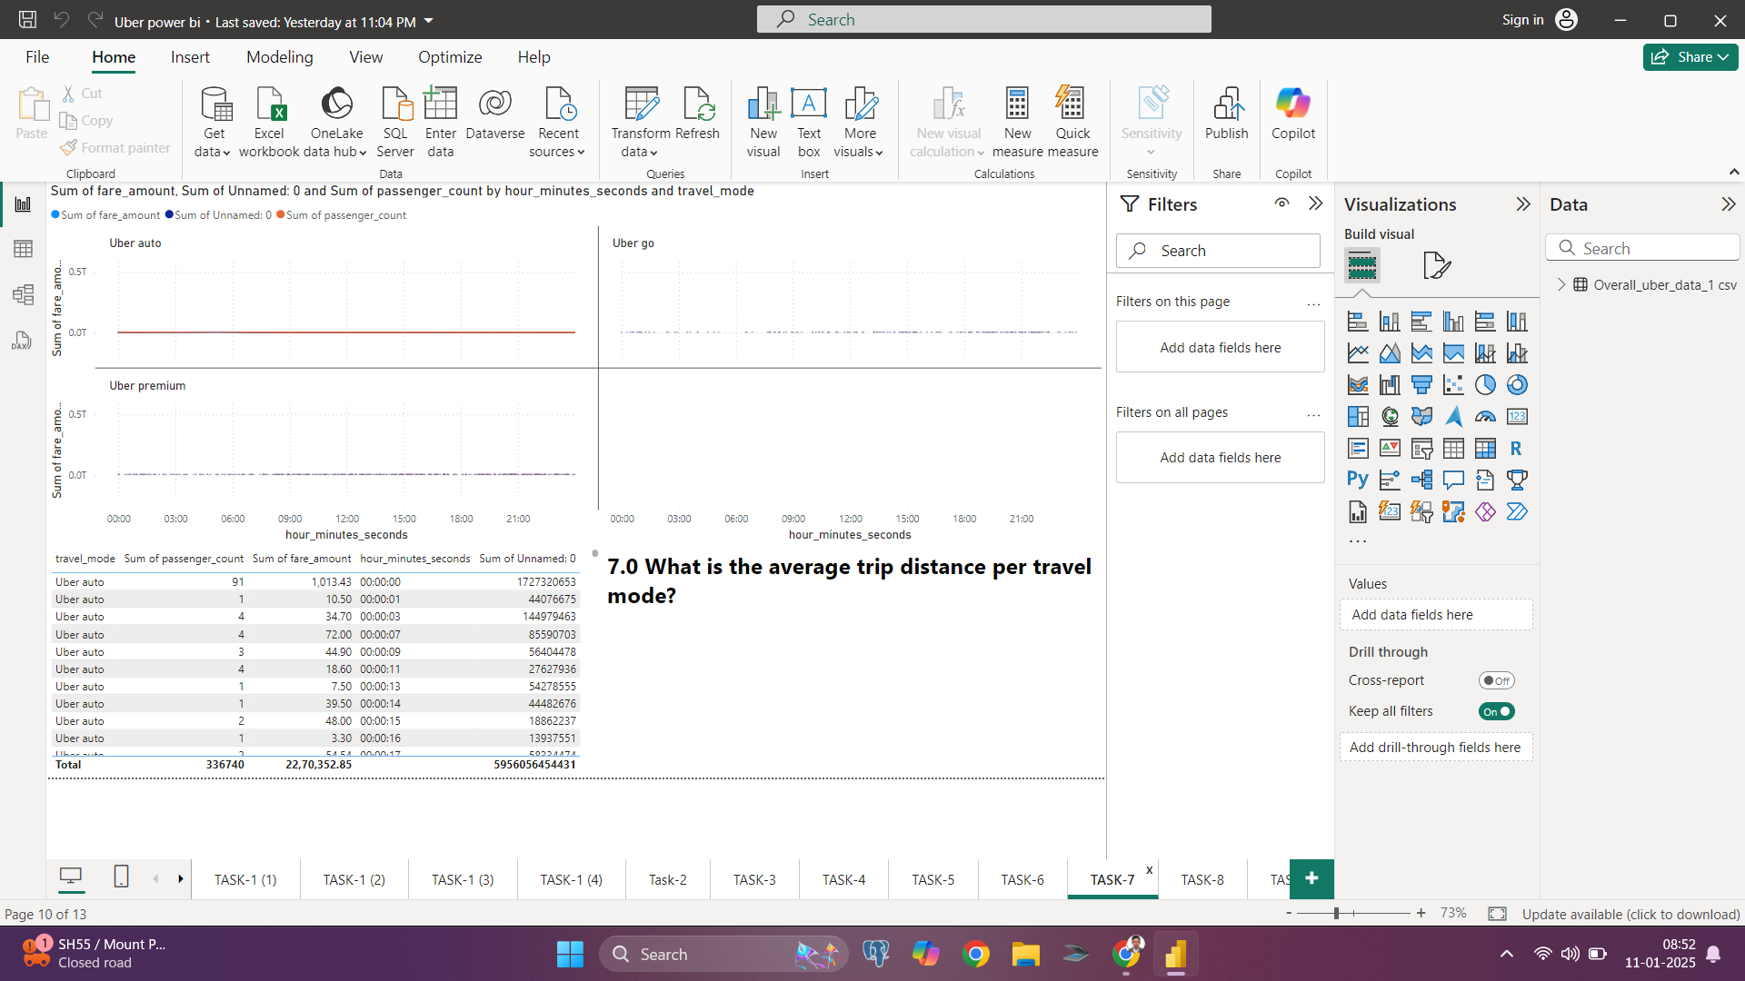
7.0 What is the average trip distance per travel mode?
Conclusion: The charts indicate that Uber Premium services tend to cover longer average distances compared to Uber Go and Uber Auto, which typically have shorter trip distances. This suggests that premium modes are preferred for long-distance travel, while budget-friendly options like Uber Auto cater to shorter, localized trips.

Slide 13
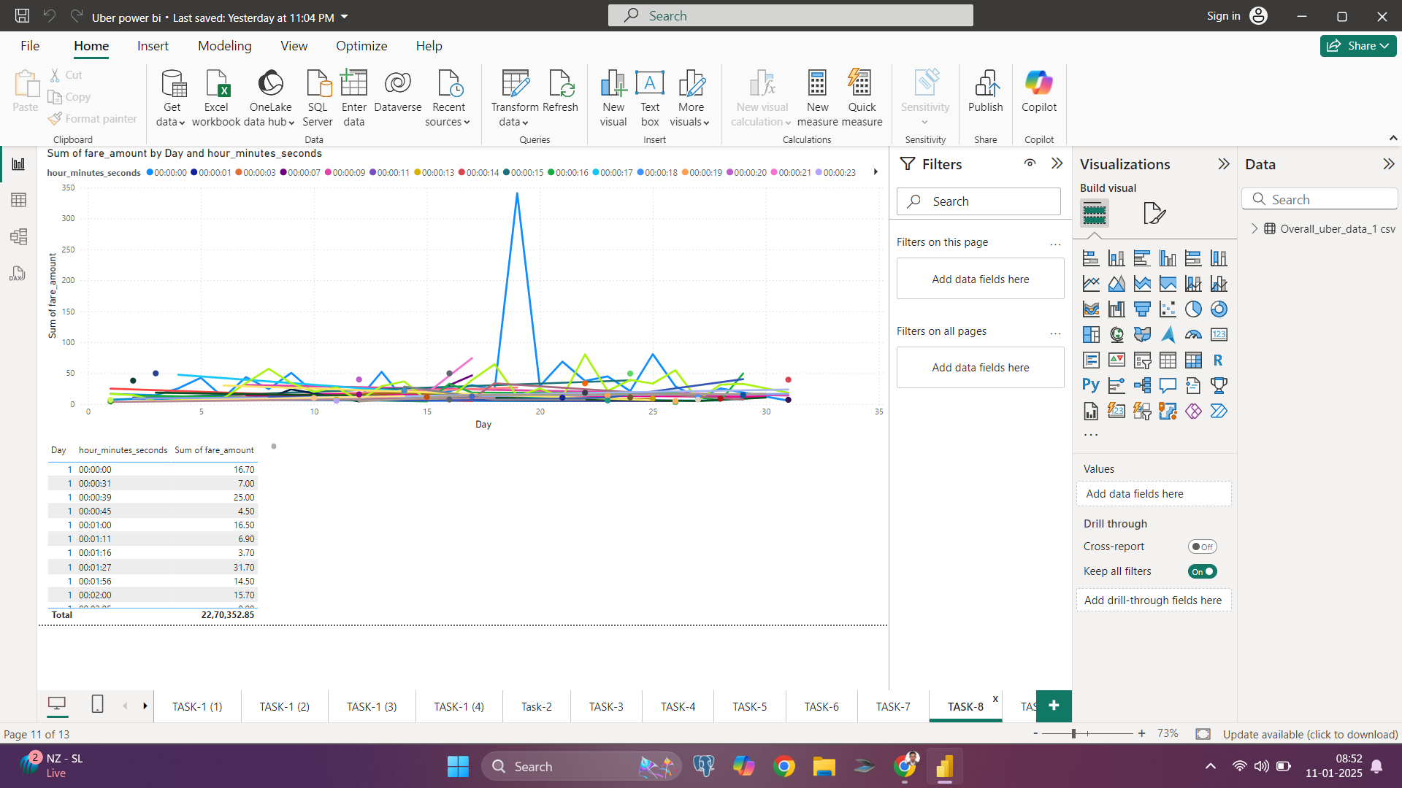
8.0 How does fare price vary by time of day?
Conclusion: The line graph shows that fare prices tend to peak during specific times, likely during high-demand periods such as morning and evening rush hours. There is a noticeable spike at one point, which could indicate a surge pricing event or an anomaly in demand.

Slide 14
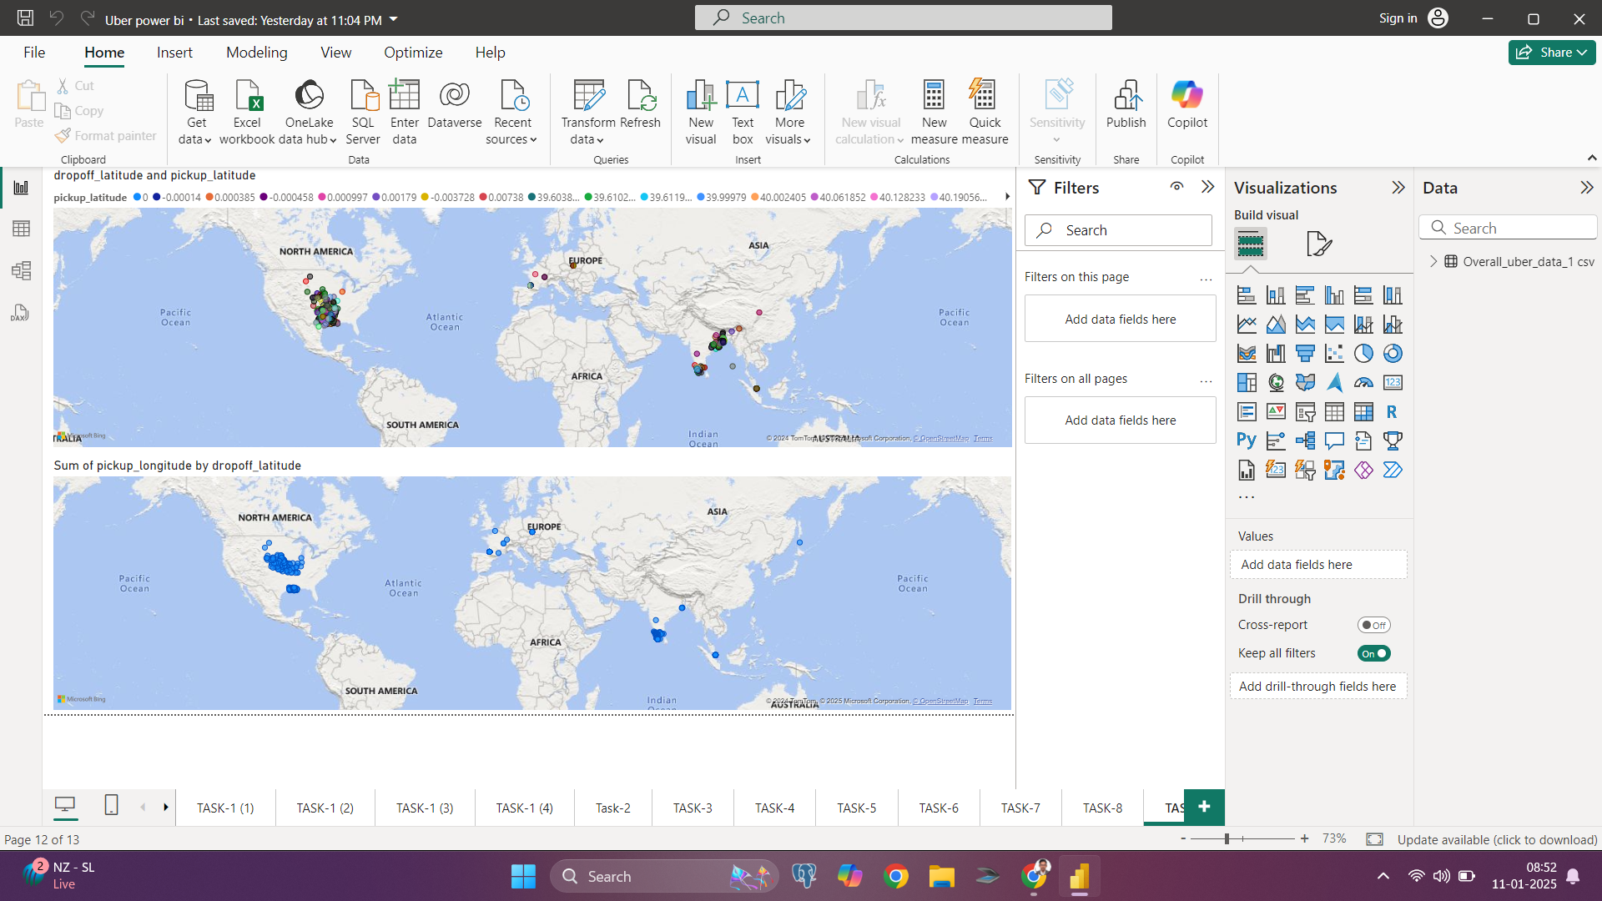
10.0 What is the average fare for rides starting or ending at specific locations?
Conclusion: The visualizations highlight key geographic trends in pickup and dropoff locations. The first map emphasizes a distribution of activity across multiple continents, with clusters primarily in North America and Asia, while the second map aggregates pickup longitude values relative to dropoff latitude, revealing dense activity in specific regions, particularly in the United States. These insights can help focus operational strategies in high-activity areas.

Slide 15

Conclusion
Based on a preliminary review of the data:
1.Revenue Insights:
Analysis of the fare_amount column can reveal trends in revenue generation across different times, locations, and modes of travel.
2. Passenger Behavior:
The passenger_count data allows us to identify peak usage trends and preferred group sizes, aiding in demand forecasting.
3. Geospatial Analysis:
Using pickup and dropoff coordinates, we can map high-demand zones, optimize routes, and identify areas requiring better service availability.
4. Temporal Trends:
Insights from pickup_datetime and hour_minutes_seconds can highlight peak travel hours and seasonal patterns for service optimization.
5. Travel Modes:
The travel_mode column offers an opportunity to compare usage and profitability across different Uber services, enabling targeted marketing and service adjustments.
Final Thought
This dataset provides valuable opportunities for understanding Uber's operations, optimizing resource allocation, and enhancing customer satisfaction. A deeper dive into the data will yield actionable insights for strategic decision-making.
Let me know if you’d like me to generate specific analyses, charts, or dashboards! ​

Slide 16
Thank You

